Slide 1

CS302 Design and Analysis of Algorithms
Muhammad sohail afzal

Slide 2
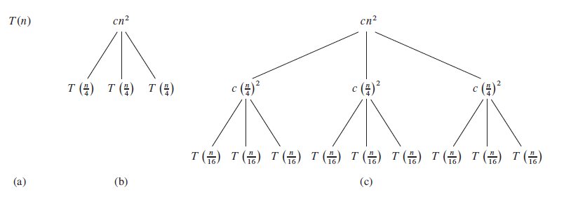
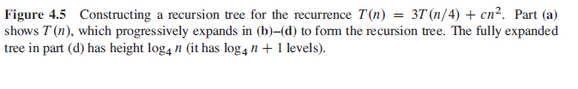
Recursion Tree Method: Solving Recurrence
Example 1: T(n) = 3T(n/4) + cn^2

Slide 3
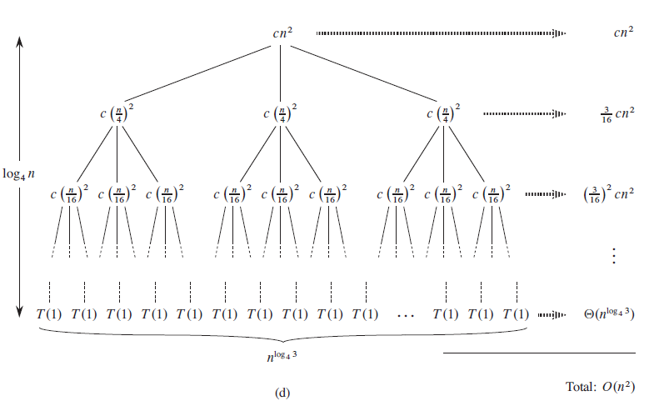
Recursion Tree Method: Solving Recurrence

Slide 4
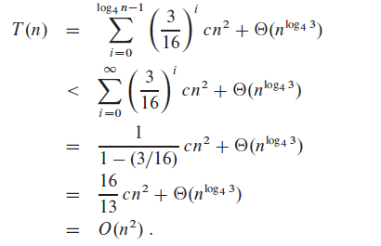
Recursion Tree Method: Solving Recurrence

Slide 5
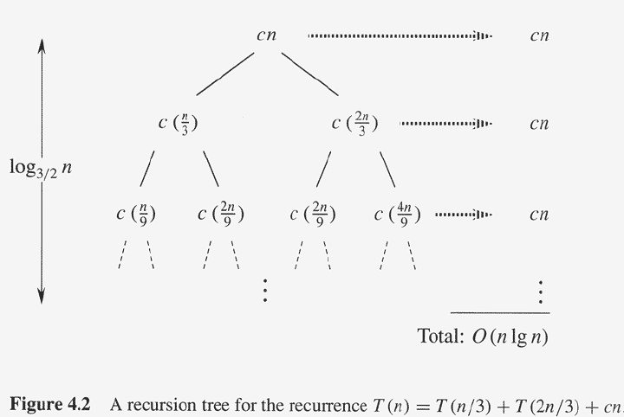
Recursion Tree Method: Solving Recurrence
Example 2: T(n) = T(n/3) + T(2n/3) + cn

Slide 6
Recursion Tree Method: Solving Recurrence
T(n) = T(n/3) + T(2n/3) + cn
While solving this question, there are two recursions i-e T(n/3) and T(2n/3).
which “i” should be taken for last level ?
There will be two “i” for last level ,one from each recursion.
Take that “i” which is largest. Because that “i” value will actually be maximum depth of tree

Slide 7
Recursion Tree Method: Solving Recurrence
Steps:
Make tree of values that are known (like cn^2 in first example) while expanding recurrence relations further to find more known values (like c(n/4)^2 and c(n/16)^2 in first example )
Sum values at each individual level of tree
Now you have got sum of values at first few levels of tree. Now find the common pattern.
This common pattern will give you a general term that will give you sum of values at any level of tree (when you put particular level number of tree in that general equation).
You need time complexity(total time) in the end so you need summation of all the values of tree at each level so you solve the sigma to find final time complexity.

Slide 8
Recursion Tree Method: Solving Recurrence
Watch these videos for understanding of “Recurrence Tree”:
https://www.youtube.com/watch?v=OXjKlxnq6C0
https://www.youtube.com/watch?v=sLNPd_nPGIc
https://www.youtube.com/watch?v=CsGg_50dj8A&t=457s

